Slide 1
Calculus
Optimization Using Derivatives | Single Variable Functions

Slide 2
Outline
Definitions
Example
Properties and More Terms
Second Derivative Test

Slide 3
Definitions
Optimization refers to finding a minimum or maximum quantity
In Calculus, it refers to finding min and max quantities of a function
These are called extreme values
In a small interval, they are local extrema
Over the entire function, they are global extrema

Slide 4
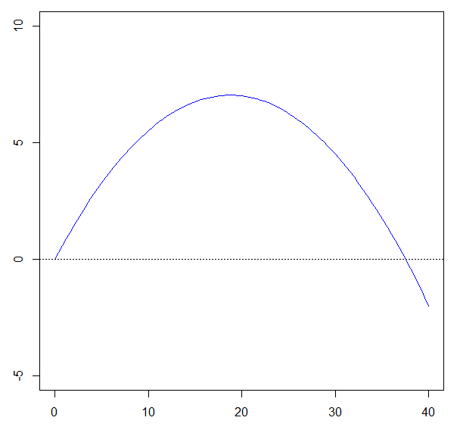
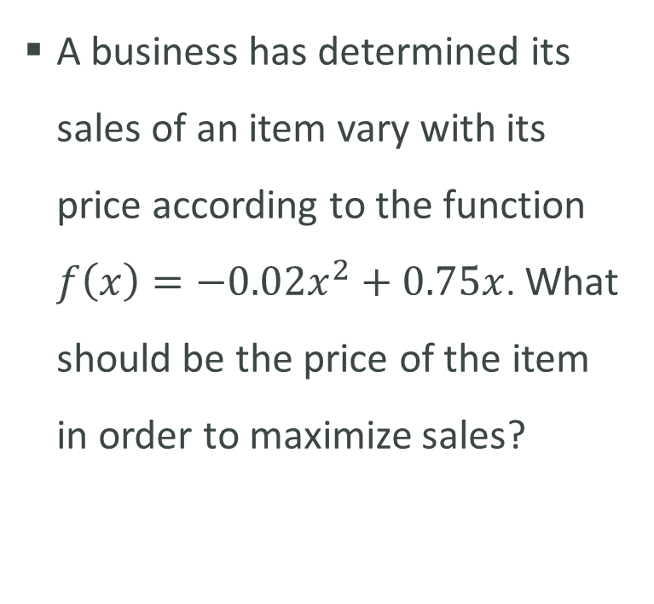

Example
A business has determined its sales of an item vary with its price according to the function $f\left(x\right)=−0.02x^{2}+0.75x$. What should be the price of the item in order to maximize sales?
Max Sales
$$f\left(x\right)=−0.02x^{2}+0.75x$$

Slide 5
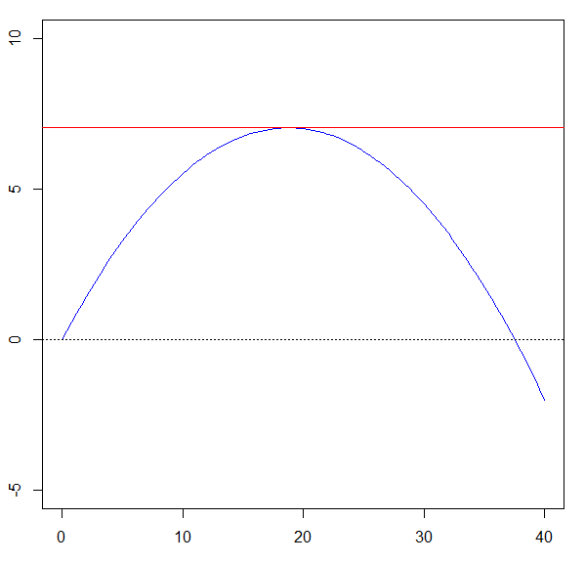
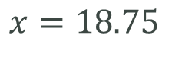
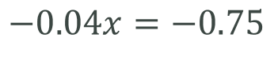
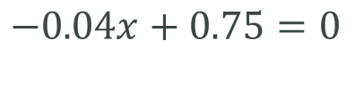
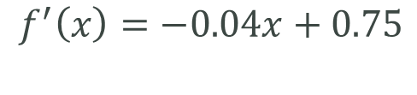
Example
How can we find where the max occurs? And exactly what the max value is?
By using the derivative!
The derivative will equal 0 where the max occurs.
We just need to find the points where the derivative equals zero.
$$f\left(x\right)=−0.02x^{2}+0.75x$$
$$f^{′}\left(x\right)=−0.04x+0.75$$
$$−0.04x+0.75=0$$
$$−0.04x=−0.75$$
$$x=18.75$$

Slide 6
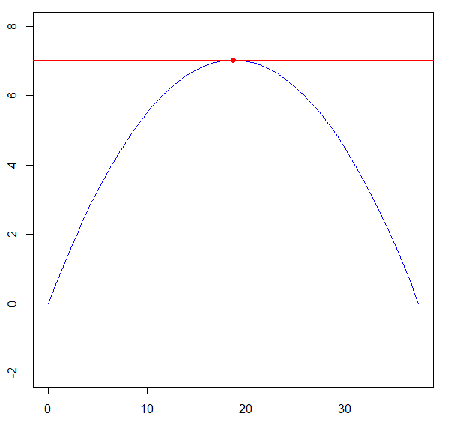
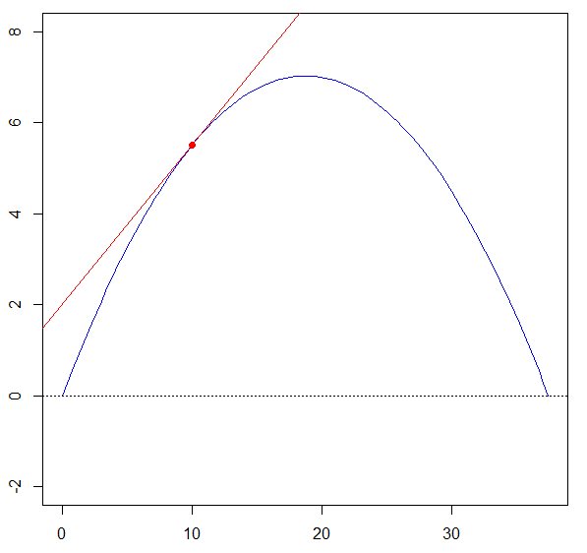
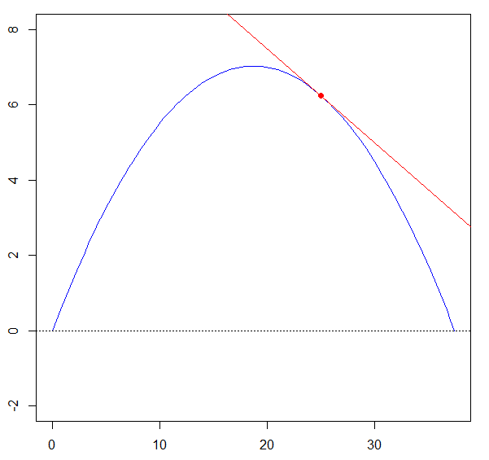



Properties and More Terms
If $f(x)$ has an extreme value at $x^{∗}$, then $f’(x^{∗})$will equal $0$.
If $f’\left(x^{∗}\right)=0$, then $x^{∗}$ is a critical point
If $f’\left(x^{∗}\right)>0$, then $f$is increasing at $x^{∗}$
If $f’\left(x^{∗}\right)<0$, then $f$ is decreasing at $x^{∗}$

Slide 7
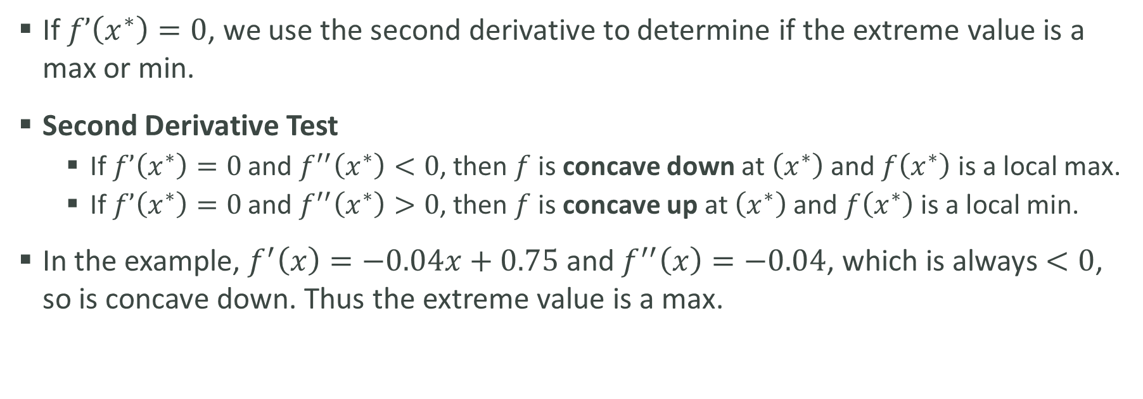
Second Derivative Test
If $f’\left(x^{∗}\right)=0$, we use the second derivative to determine if the extreme value is a max or min.
Second Derivative Test
If $f’\left(x^{∗}\right)=0$ and $f^{′′}\left(x^{∗}\right)<0$, then $f$ is concave down at $\left(x^{∗}\right)$ and $f\left(x^{∗}\right)$ is a local max.
If $f’\left(x^{∗}\right)=0$ and $f^{′′}\left(x^{∗}\right)>0$, then $f$ is concave up at $\left(x^{∗}\right)$ and $f\left(x^{∗}\right)$ is a local min.
In the example, $f^{′}\left(x\right)=−0.04x+0.75$ and $f^{′′}\left(x\right)=−0.04$, which is always $<0$, so is concave down. Thus the extreme value is a max.

